Slide 1
OLAP
KJSCE
83

Slide 2
WHAT AND WHY OLAP?
OLAP is the dynamic synthesis, analysis, and consolidation of large volumes of multi-dimensional data.
OLAP is the term that describes a technology that uses multi- dimensional view of aggregate data to provide quick access to strategic information for the purposes of advanced analysis.
OLAP enables users to gain a deeper understanding and knowledge about various aspects of their corporate data through fast, consistent, interactive access to a variety of possible views of data.
While OLAP systems can easily answer ‘who?’ and ‘what?’ questions, it has easier ability to answer ‘what if?’ and ‘why?’ type questions that distinguishes them from general-purpose query tools.
The types of analysis available from OLAP range from basic navigation and browsing (referred to as ‘slicing’ and dicing’) , to calculations, to more complex analysis such as time series and complex modeling.

Slide 3
OLAP APPLICATIONS
Finance: Budgeting, activity-based costing, performance analysis, and financial modeling.
financial
Sales: Sales analysis and sales forecasting.
Marketing: Market research analysis, sales forecasting, promotions analysis, customer analysis, and market/customer segmentation.
Manufacturing: Production planning and defect analysis.

Slide 4
OLAP KEY FEATURES
Multi-dimensional views of data.
Support for complex calculations.
Time Intelligence.

Slide 5
THE DATA CUBE
Multidimensional databases (sometimes called OLAP) are specialized data stores that organize facts by dimensions, such as geographical region, product line, salesperson, time. The data in these databases are usually preprocessed and stored in data cubes.
One intersection might be the quantities of a product sold by specific retail locations during certain time periods.
Another matrix might be Sales volume by department, by
day, by month, by year for a specific region
Cubes provide faster:
Queries
Slices and Dices of the information
Rollups
Drill Downs

Slide 6
TYPICAL OLAP OPERATIONS
Roll up (drill-up): summarize data
by climbing up hierarchy or by dimension reduction
Drill down (roll down): reverse of roll-up
from higher level summary to lower level summary or detailed data, or introducing new dimensions
Slice and dice: project and select
Pivot (rotate):
reorient the cube, visualization, 3D to series of 2D planes
Other operations
drill across: involving (across) more than one fact table
drill through: through the bottom level of the cube to its
back-end relational tables (using SQL)
KJSCE 89

Slide 7
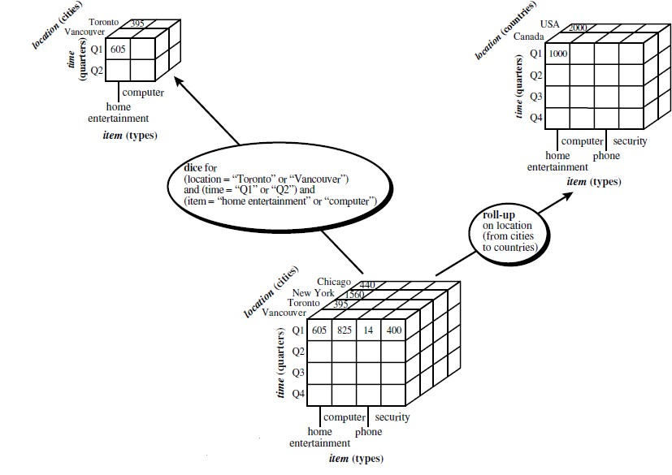

Slide 8
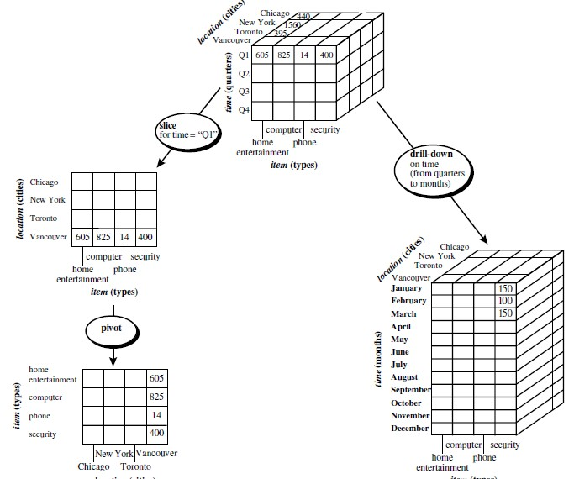

Slide 9
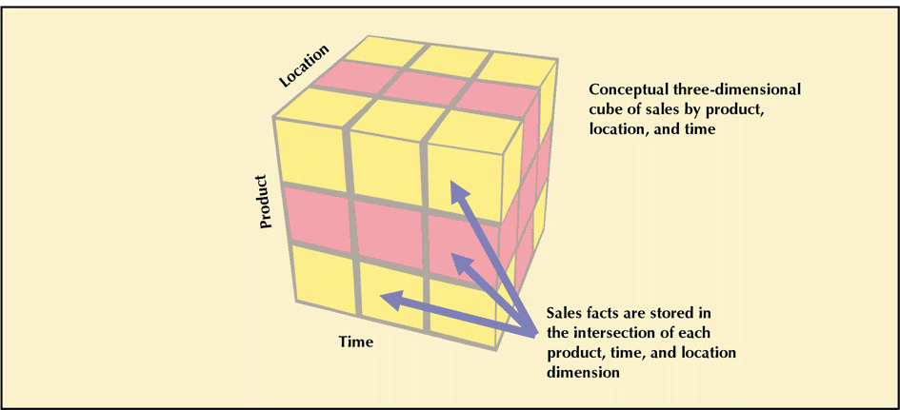
THREE-DIMENSIONAL VIEW OF SALES

Slide 10

MULTIDIMENSIONAL DATA
Sales volume as a function of product, month, and
region
Dimensions: Product, Location, Time
Hierarchical summarization paths
Industry Region Year Category Country Quarter Product City Month Week
Office Day
Month
Product
KJSCE
93

Slide 11
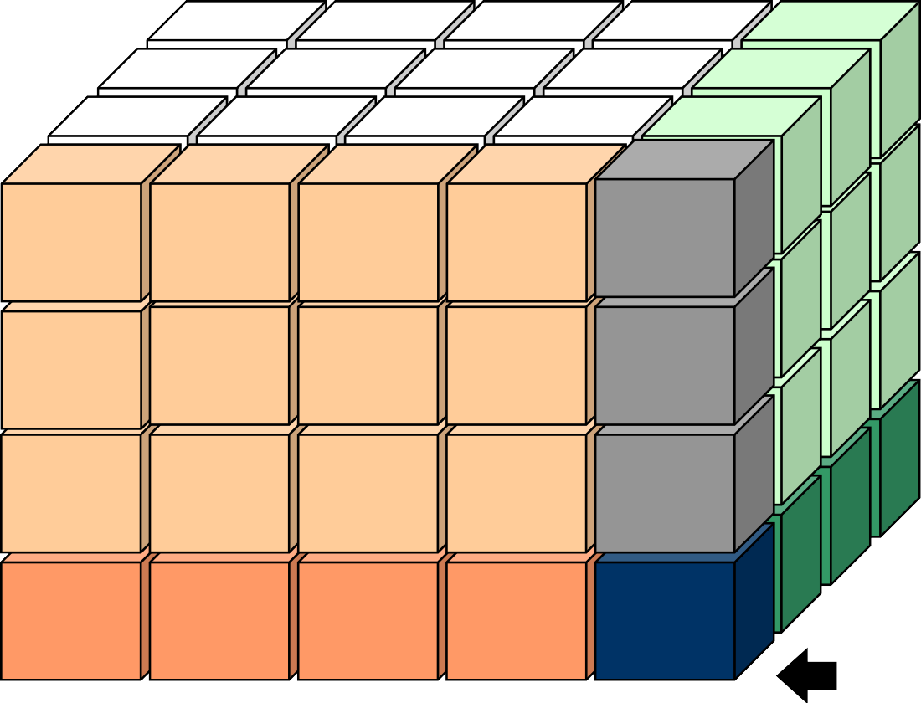


A SAMPLE DATA CUBE
Date
3Qtr
Total annual sales
of TVs in U.S.A.
1Qtr
2Qtr
4Qtr
sum
TV PC
VCR
sum
U.S.A
94
Canada
Country
Mexico
sum
KJS CE

Slide 12
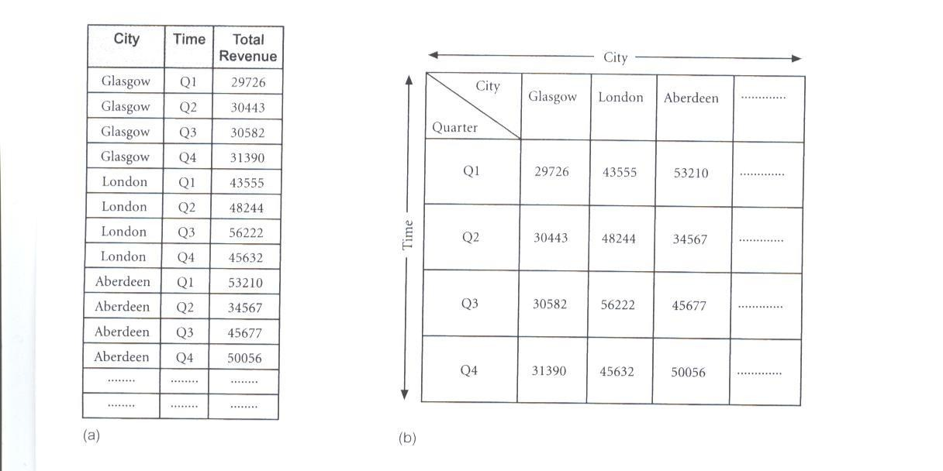
REPRESENTATION OF MULTI-DIMENSIONAL DATA
OLAP database servers use multi-dimensional structures to store data and relationships between data.
Multi-dimensional structures are best-visualized as cubes of data, and cubes within cubes of data. Each side of a cube is a dimension.

Slide 13
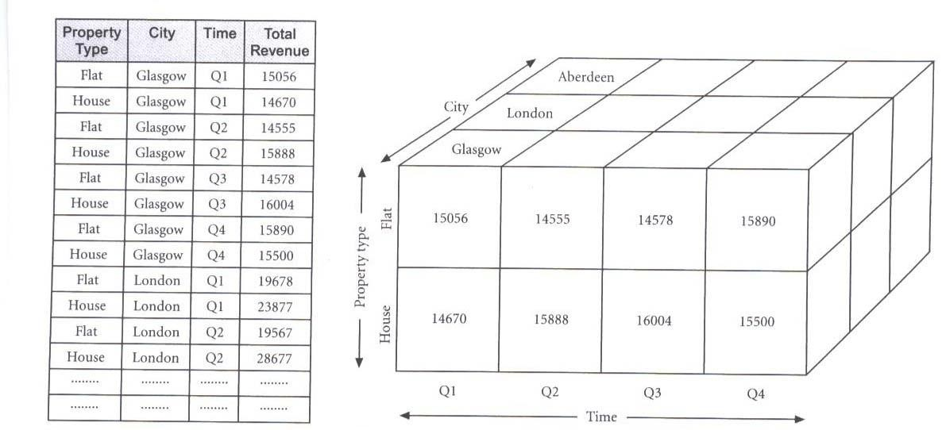
REPRESENTATION OF MULTI-DIMENSIONAL DATA
Multi-dimensional databases are a compact and easy-to-understand way of visualizing and manipulating data elements that have many inter-relationships.
The cube can be expanded to include another dimension, for example, the number of sales staff in each city.
The response time of a multi-dimensional query depends on how many cells have to be added on-the-fly.
As the number of dimensions increases, the number of cube’s cells
increases exponentially.

Slide 14
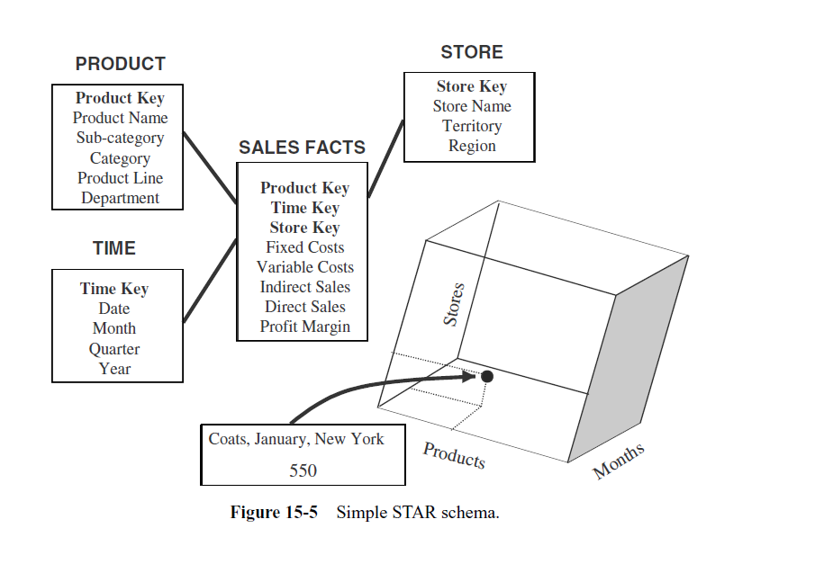

Slide 15
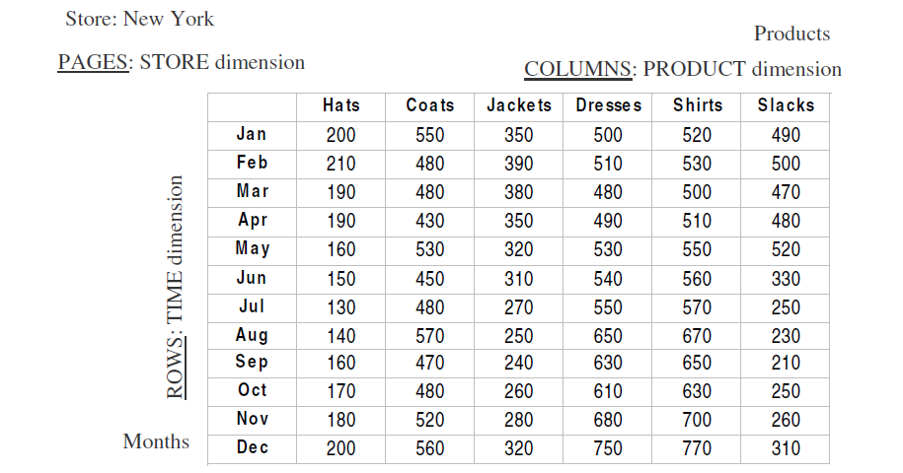

Slide 16
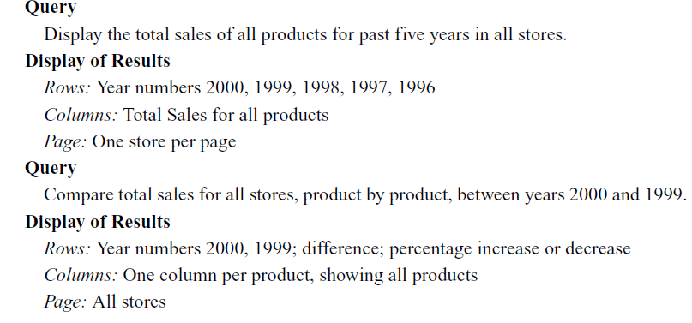

Slide 17
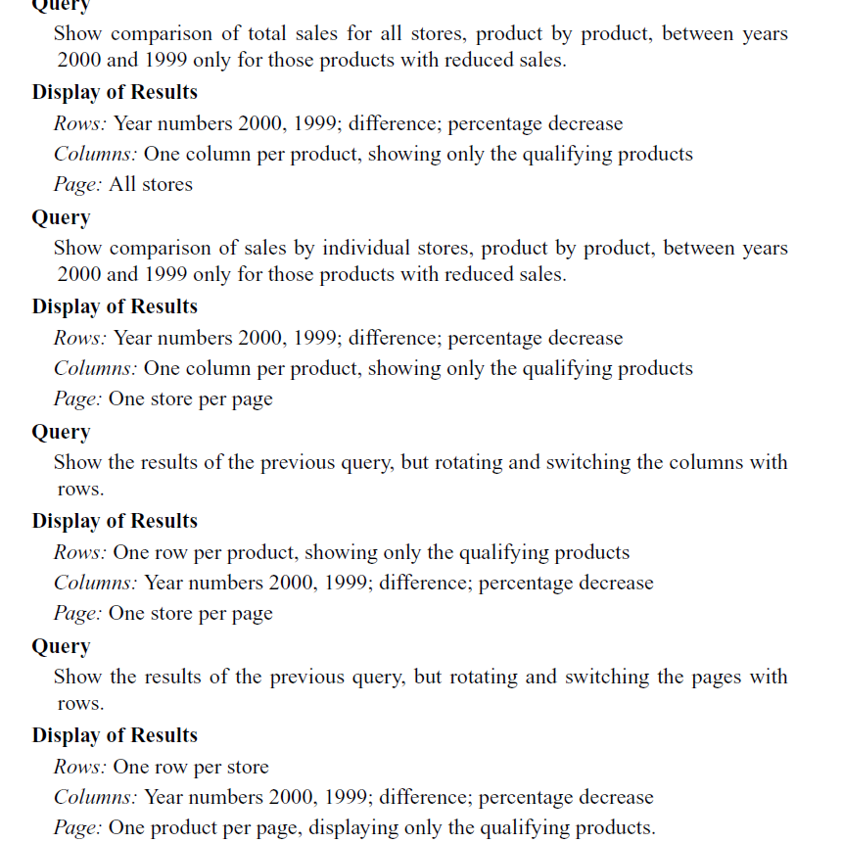

Slide 18
OLAP TOOLS - CATEGORIES
OLAP tools are categorized according to the architecture used to store and process multi- dimensional data.
The main categories of OLAP tools :
Multi-dimensional OLAP (MOLAP)
Relational OLAP (ROLAP)
Hybrid OLAP (HOLAP)

Slide 19
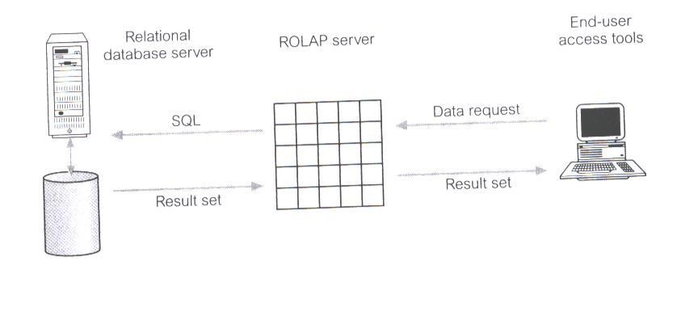
RELATIONAL OLAP (ROLAP)
ROLAP is the fastest-growing type of OLAP tools.
ROLAP supports RDBMS products through the use of a metadata layer, thus avoiding
the requirement to create a static multi-dimensional data structure.
This facilitates the creation of multiple multi-dimensional views
dimensional relation.
of the two-
To improve performance, some ROLAP products have enhanced SQL engines to
support the complexity of multi-dimensional analysis, while others recommend, or
require, the use of highly denormalized database designs such as the star schema.
The development issues associated with ROLAP technology:
Performance problems associated with the processing of complex queries that require multiple passes through the relational data.
Development of middleware to facilitate the development of multi-dimensional applications.
Development of an option to create persistent multi-dimensional structures,
together with facilities o assist in the administration of these structures.

Slide 20
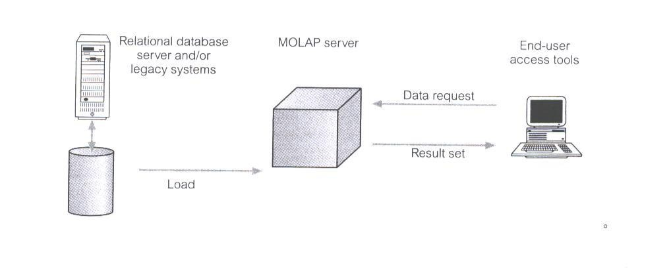
MULTI-DIMENSIONAL OLAP (MOLAP)
MOLAP tools use specialized data structures and multi-dimensional database management systems (MDDBMS) to organize, navigate, and analyze data.
To enhance query performance the data is typically aggregated and stored according to predicted usage.
MOLAP data structures use array technology and efficient storage techniques that minimize the disk space requirements through sparse data management.
MOLAP is well-suited for scenarios requiring fast query response times, especially with smaller to medium-sized data sets.
Example: An inventory manager uses MOLAP to analyze inventory levels across multiple warehouses, product categories, and time periods using a multidimensional cube structure.
The development issues associated with MOLAP:
Only a limited amount of data can be efficiently stored and analyzed.
Navigation and analysis of data are limited because the data is designed according to previously determined requirements.
MOLAP products require a different set of skills and tools to build and
maintain the database.

Slide 21
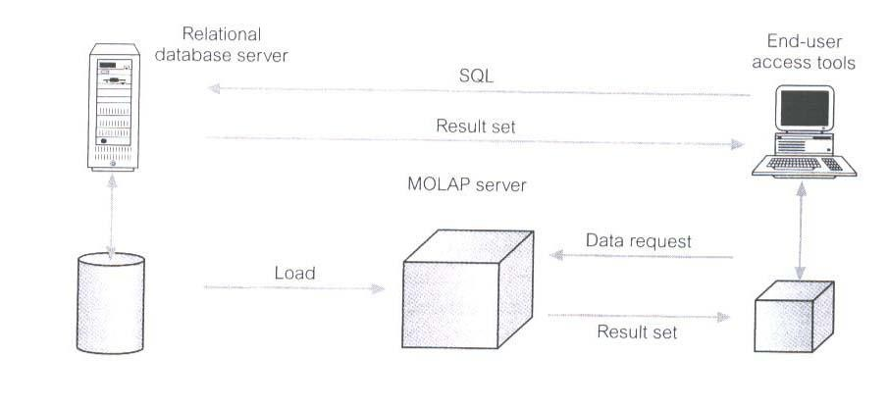
HYBRID OLAP (HOLAP)
HOLAP tools provide limited analysis capability, either directly against RDBMS products, or by using an intermediate MOLAP server.
HOLAP tools deliver selected data directly from DBMS or via MOLAP server to the desktop (or local server) in the form of data cube, where it is stored, analyzed, and maintained locally is the fastest-growing type of OLAP tools.
HOLAP is often used when dealing with large data volumes where some data requires the performance benefits of MOLAP, while other data is better suited to the flexibility of ROLAP.
Example: A retail chain uses HOLAP to analyze sales data, storing detailed transaction data in relational tables for flexibility and summary data in a multidimensional cube for faster analysis.
The issues associated with HOLAP tools:
The architecture results in significant data redundancy and may cause problems for networks that support many users.
Ability of each user to build a custom data cube may cause a lack
of data consistency among users.
Only a limited amount of data can be efficiently maintained.

